Slide 1
Report and Analysis
This is a brief report of the various analysis i.e. performed including the dashboard and different KPI's and metrics

Slide 2
Table of content:
Business Context
Problem Statement
Data Availability
Glossary
Data Model
Technology Stack
Data Checks
Exploratory Data Analysis
Traffic and Channel Based Analysis
Seasonality Based Analysis
Product Level Analysis
Website Performance
User Analysis

Slide 3
Business Context
Overview:
The newly launched e-commerce retail start-up sells stuffed animal toys.
The company is planning to secure the next round of funding.
The CEO of the company needs to deliver a compelling business pitch to investors.
Objectives:
Create dashboards for different stakeholders to track business metrics and KPIs regularly.
Enable data-driven decision-making for stakeholders.
Provide detailed analysis of company performance and new product analysis.
Deliver a captivating business pitch by showcasing traffic analysis, website performance, progress of new products, and relevant insights and reports.

Slide 4
Problem Statement
Primary Challenge:
Creating comprehensive dashboards and detailed analysis to aid in securing funding and improving performance.
Specific Needs:
Company performance Analysis
Traffic Analysis & Website Performance
Products Insights
Reports for Investor Presentations

Slide 5

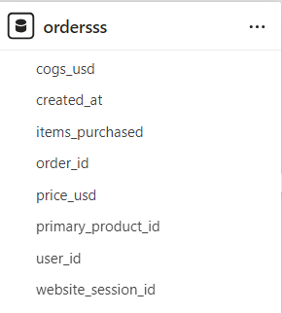
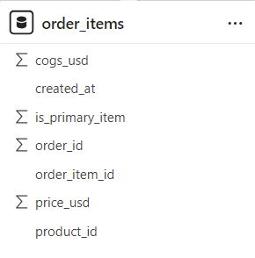
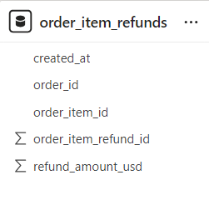


Data Availability

Slide 6
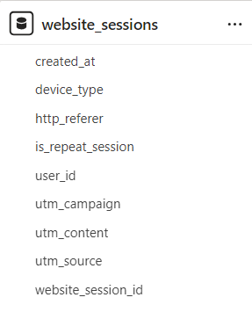
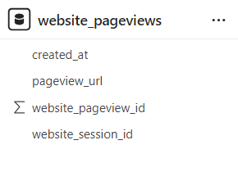
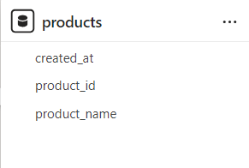
Data Availability

Slide 7
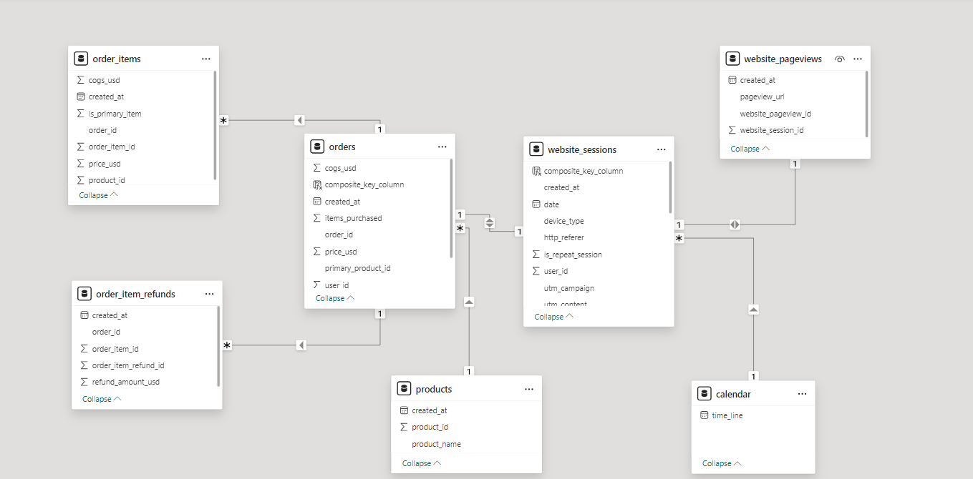
Data Model

Slide 8


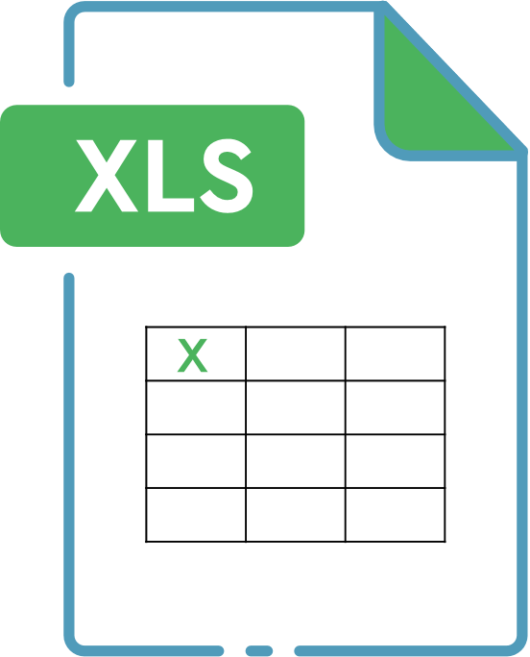
Technology Stack
The technology stack refers to the tools and platforms used for data extraction, transformation, loading (ETL), analysis, and visualization.
Excel: For initial data exploration and preliminary analysis.
SQL: For data extraction, transformation, and analysis.
PowerBI: For creating interactive dashboards and visualizations.

Slide 9
Integrity Checks:
Ensured relationships between tables are maintained.
Checked for duplicate rows
Consistency Checks:
Data formats verified(e.g., dates, numeric values).
Completeness Checks:
Checked for missing values.
Ensure all necessary columns are populated.
NULL valued handled
Accuracy Checks:
Cross-checked totals and subtotals against source data.
Detailed List of Data Checks

Slide 10
Exploratory Data Analysis
Total Orders
32k
Total Revenue
$ 1.94M
Total Cost
$ 969K
Total Gross Profit
196%
Total Unit Sold
40K
Total Refunded orders
1.7K
Total Refunded Amount
$ 85K
Product Wise Distribution of Revenue
The Original Mr. Fuzzy
$1.2M
The Forever Love Bear
$350K
The Birthday Sugar Panda
$229K
$150.5K
The Hudson River Mini bear

Slide 11
Exploratory Data Analysis
Total Pageview Id
1.1M
Total website session
473K
Total repeat session
78.5K
Total G_search session
316.04K
G_search CVR
6.75%
Repeat Session Rate
16.61%

Slide 12
Finding Top Traffic Sources
Utm_source | Utm_campaign | Http_referer | Session_count
gsearch | nonbrand | https://www.gsearch.com | 3613
Direct Type-In | direct | NULL | 28
Organic | Organic | https://www.gsearch.com | 27
gsearch | brand | https://www.gsearch.com | 26
Organic | Organic | https://www.bsearch.com | 7
bsearch | brand | https://www.bsearch.com | 7
Insights :
Dominant Traffic Source: The majority of the sessions are driven by gsearch with a significant session count of 3,613 for the nonbrand
Effectiveness of Campaigns: For gsearch, the nonbrand campaign is significantly more effective than the brand campaign, with 3,613 sessions compared to 26 sessions. This highlights the importance of non-branded search terms for attracting traffic.
Referral Traffic: Most of the traffic from gsearch and bsearch comes through their respective referring domains (https://www.gsearch.com and https://www.bsearch.com).

Slide 13

Recommended Actions For Traffic Sources
Enhance Nonbrand Campaigns:
Given the high performance of gsearch nonbrand, consider allocating more budget and resources to non-brand campaigns.
Optimize Brand Campaigns:
Investigate why the brand campaigns for both gsearch and bsearch are underperforming. Adjust keywords, ad copy, and targeting to improve these campaigns.
Improve Organic Traffic:
Work on SEO strategies to increase the organic traffic from both gsearch and bsearch.
Increase Direct Traffic:
Implement brand awareness campaigns to encourage more direct visits. This could include offline marketing efforts and promotional campaigns that encourage users to visit the website directly.

Slide 14
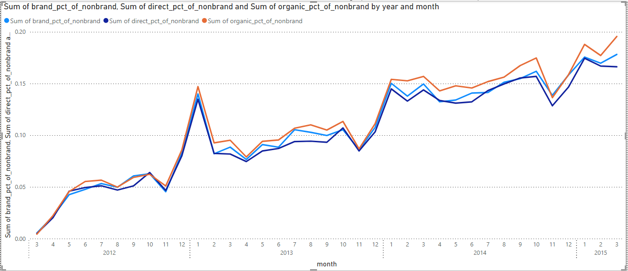
Analyzing Free Channels
Insights:
Overall Trends:
All three categories (brand, direct, and organic percentages of nonbrand) show an increasing trend over time.
This suggests that efforts in all three areas have been effective in driving nonbrand traffic.
Brand Percentage of Nonbrand:
The brand percentage of nonbrand exhibits significant growth starting from January 2013 onwards.
Seasonal Peaks:
Notably, there are peaks in all categories around December each year.

Slide 15
Recommendations For Free Channel
Continue investing in branding efforts, as this trend indicates positive results.
Explore strategies to further enhance brand visibility.
Capitalize on these seasonal peaks by aligning marketing efforts with holiday seasons.
Consider targeted campaigns during peak months.
The increase in brand sessions relative to nonbrand sessions indicates a growing brand loyalty. Invest in brand-building campaigns to further enhance brand recognition.
The growth in direct traffic suggests strong brand loyalty. Encourage direct visits by providing an excellent user experience and creating a seamless, memorable site.
The data shows peaks in traffic during November and December. Plan and execute targeted seasonal campaigns well in advance of these peak periods to capitalize on the increased traffic.
Offer special promotions, discounts, and exclusive products during the holiday season to attract more visitors and increase conversion rates.

Slide 16
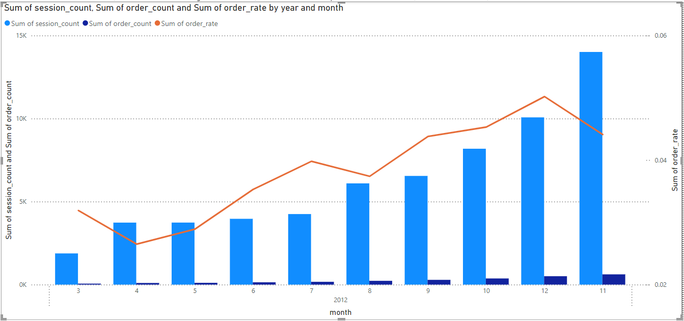
Analyzing Seasonality (Monthly Volume Pattern)
Insights :
Growth in Session Count:
Sessions increased from 1,879 in March 2012 to 10,072 in December 2012, indicating growing website traffic.
Order Count Trend:
Orders rose steadily from 60 in March to 506 in December, showing effective traffic conversion.
Order Rate Fluctuation:
The order rate varied, starting at 0.0319 in March, peaking at 0.0502 in December, reflecting improving but fluctuating conversion efficiency.
Seasonal Peaks:
Significant peaks in sessions (14,011) and orders (618) occurred in November, with December maintaining high traffic and the highest order rate of 0.0502.

Slide 17
Recommendations
Optimize for Peak Seasons:
Given the significant increase in sessions and orders during November and December, focus marketing efforts and inventory management to prepare for the holiday season. Consider special promotions, discounts, and ensuring sufficient stock levels.
Conversion Rate Optimization:
While the order rate is generally increasing, there are fluctuations. Conduct A/B testing on landing pages, checkout processes, and call-to-action elements to identify what drives higher conversions during months with lower order rates.
Sustain Traffic Growth:
Since there is consistent growth in session count, continue investing in successful traffic acquisition channels (e.g., SEO, PPC, social media marketing). Monitor which channels are most effective and allocate budget accordingly.
Customer Retention:
With increasing orders, focus on retaining customers by implementing loyalty programs, personalized marketing, and post-purchase follow-ups to encourage repeat purchases.
Analyze Order Patterns:
Investigate why certain months have higher order rates and apply those insights to other months. This could involve analyzing marketing campaigns, promotions, or external factors influencing consumer behavior.

Slide 18
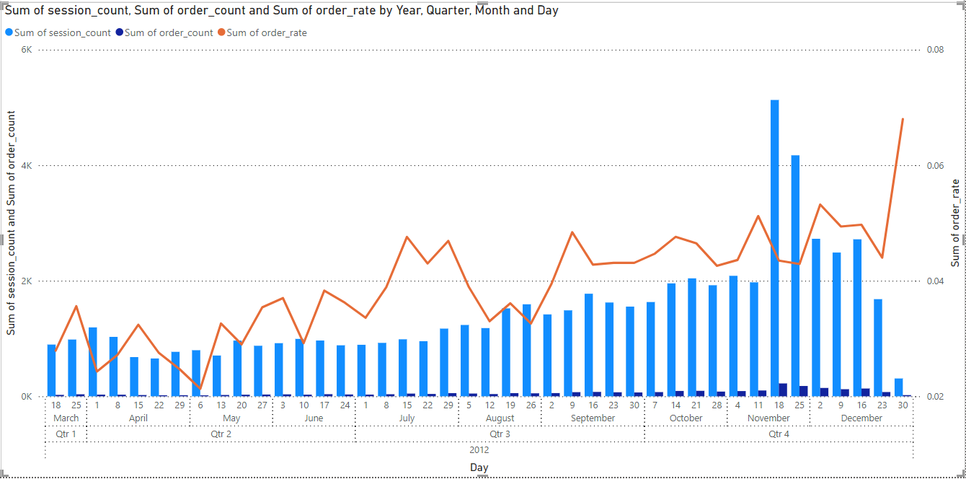
Analyzing Seasonality (Weekly Volume Pattern)

Slide 19
Growth in Session Count:
Sessions increased from 896 (week of March 18) to a peak of 5,130 (week of November 18).
Significant spikes in sessions in November suggest high holiday traffic.
Order Count Trend:
Orders rose from 25 (week of March 18) to 223 (week of November 18).
Notable spikes in orders align with holiday season traffic in November and December.
Order Rate Fluctuation:
Order rate grew from 0.0279 (week of March 18) to 0.0680 (week of December 30).
Higher order rates observed during the holiday season, especially in early and late December.
Seasonal Peaks:
Peaks in sessions and orders during November and December indicate higher engagement and conversions during holidays.
Insights :​

Slide 20
Holiday Season Campaigns:
Intensify marketing efforts during the holiday season to leverage traffic spikes. Ensure the website can handle increased traffic and provide a seamless shopping experience.
Year-Round Engagement:
Maintain high engagement and conversion rates throughout the year with loyalty programs, regular promotions, and personalized marketing.
Targeted Marketing:
Use session and order data to segment the audience and create focused marketing campaigns. Prioritize high-performing weeks and demographics to maximize ROI.
Website Performance:
Optimize website performance, especially during high-traffic periods. Regularly test and improve site speed, mobile compatibility, and user interface to enhance user experience and reduce bounce rates.
Recommendations :

Slide 21
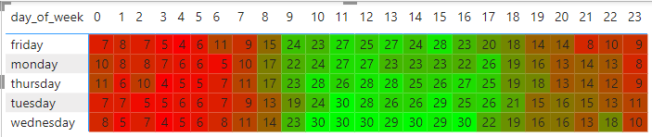
Analyzing Business Patterns
Highest and lowest performing weeks:
While analysing it was observed that weekends and holidays have less visits compared to working days, as was requested by the CEO we have removed public holidays and weekends
Peak time for purchases:
from the heat wave graph we can see that 9 am to 5pm is the time where most people buy products
To increase purchases on weekends we can introduce weekend offers

Slide 22
Insights
Peak Hours:
Peak session volumes occur mid-morning to early afternoon (9 AM - 3 PM), with highest volumes between 10 AM and 3 PM.
Day-Specific Trends:
Wednesday has the highest session volumes, especially from 9 AM to 4 PM.
Thursday and Tuesday also have high session volumes, particularly late morning to early afternoon.
Monday and Friday show increased activity mid-morning to early afternoon but are lower than Wednesday and Thursday.
Low Traffic Periods:
Early mornings (12 AM - 7 AM) and evenings after 6 PM show consistently low session volumes.
Hourly Trends:
Session volumes peak from 10 AM to 1 PM, gradually decreasing after 3 PM.

Slide 23
Recommendations
Staffing for Peak Hours:
Focus staffing live chat support from 9 AM to 3 PM, with highest staff levels during these hours.
Day-Specific Adjustments:
Increase staffing slightly on Wednesday, Thursday, and Tuesday, especially during peak hours.
Minimal Staffing During Low Traffic Periods:
Minimize staffing from 12 AM to 7 AM and after 6 PM, using automated support during these times.
Flexible Staffing Approach:
Adjust staffing based on real-time traffic patterns and historical data insights.
Leverage Automated Support Tools:
Use chatbots for basic queries during off-peak hours and to assist during peak hours, allowing live agents to handle complex issues.

Slide 24
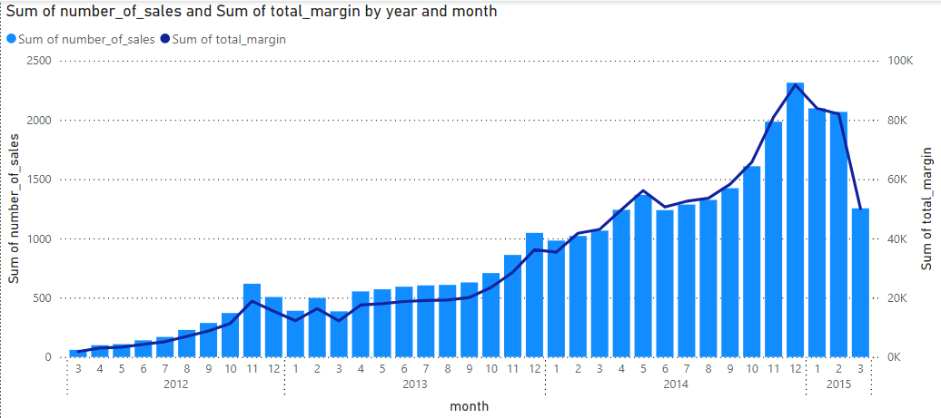
Product Level Sales Analysis
This chart shows count of sales and total margin plotted against months starting from March 2012 to march 2015
The data shows a consistent increase in the number of sales, total revenue, and total margin from 2012 to early 2015.

Slide 25
Insights
Overall Growth:
There are significant spikes in sales and revenue during November and December, indicating strong holiday season performance.
Yearly Trends:
Each year demonstrates growth over the previous year, particularly evident from 2013 onwards.
The number of sales, total revenue, and total margin see their highest values in November and December each year.
Seasonal Peaks:
November and December are peak months for sales, revenue, and margin, suggesting successful holiday promotions and campaigns.
There is a noticeable dip in January and February, followed by a gradual increase starting from March.
Monthly Variations:
The highest monthly sales were in December 2014 with 2,314 sales, generating a revenue of $144,823 and a margin of $91,857.
The lowest sales were in March 2012, with 60 sales, generating a revenue of $2,999 and a margin of $1,830.

Slide 26
Recommendations​
Leverage Peak Seasons:
Continue to capitalize on the holiday season with targeted marketing campaigns, promotions, and inventory management.
Consider launching new products or special offers in November and December to maximize sales and revenue.
Year-Round Engagement:
Develop strategies to sustain engagement and sales throughout the year. This can include loyalty programs, monthly promotions, and consistent marketing efforts.
Analyze the factors contributing to the lower sales in January and February and address these to reduce the seasonal dip.
Product Launch Timing:
Plan new product launches around peak sales periods (e.g., early November) to take advantage of increased customer traffic and spending.
Ensure robust marketing and promotional strategies are in place to create buzz and drive sales.
Continuous Improvement:
Regularly review sales data and trends to identify opportunities for growth and improvement.

Slide 27
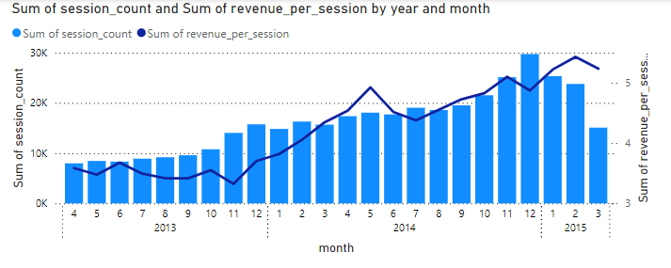
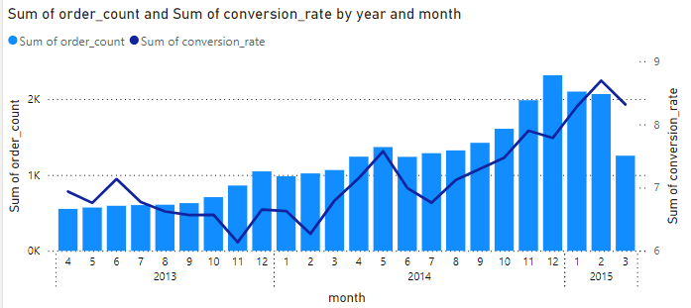
Product Launch Sales Analysis
Revenue per session and session count is plotted against month of the year from April 2013 to March 2015
Consistant growth in revenue per session with the growing session count indicates increased conversion rate
Revenue per session and session count is plotted against month of the year from April 2013 to March 2015

Slide 28
Insights​
Revenue Growth:
From April 2013 to March 2015, the total revenue has reached $1.74 million, indicating steady growth over the two-year period..
Conversion Rates:
The conversion rate generally fluctuates between 6% and 8%, with notable peaks in the later months of the analysis. The highest conversion rate is observed in February 2015 at 8.69%.
Revenue Per Session:
Revenue per session consistently increases over time, reaching its peak in February 2015 at $5.43. This indicates that customers are spending more per session as time progresses.
The increase in revenue per session suggests improved customer targeting and possibly better website optimization and user experience.
Monthly Session and Order Trends:
Sessions and orders show a steady increase, with significant spikes during the holiday season in November and December.
Peak session counts are observed in December 2014 with 29,722 sessions, resulting in the highest monthly revenue of $144,823.

Slide 29
Recommendations
Maximize Holiday Campaigns:
Given the substantial increase in revenue and sessions during November and December, continue to invest heavily in holiday marketing campaigns.
Consider launching new products or exclusive holiday offers to capitalize on the increased traffic and spending.
Enhance Conversion Strategies:
Focus on strategies that have previously led to higher conversion rates, such as personalized marketing, targeted promotions, and improved user experience.
Use data analytics to identify and replicate successful tactics from months with peak conversion rates.
Year-Round Engagement:
Develop year-round engagement strategies to maintain steady growth outside the holiday season. This can include loyalty programs, monthly promotions, and regular communication with customers.
Analyze the factors leading to lower engagement during certain months and address them proactively.
Leverage Data Insights:
Use historical data to predict future trends and plan inventory, marketing, and staffing accordingly.
Implement a data-driven approach to identify high-performing channels and demographics, tailoring marketing efforts to maximize ROI.

Slide 30
Portfolio Expansion Analysis
Insights
Improved Conversion Rate:
The conversion rate increased from 6.05% pre-launch to 7.02% post-launch, indicating that the introduction of the Birthday Bear had a positive impact on converting sessions into orders.
Increased Average Order Value (AOV):
The AOV rose from $54.19 to $56.93 post-launch, suggesting that customers are spending more per order after the launch of the new product. This may be due to the added appeal of the Birthday Bear, potentially encouraging customers to add more items to their cart.
Higher Revenue Per Session:
Revenue per session saw a significant increase from $3.28 to $4.00 post-launch. This indicates that the launch of the Birthday Bear not only attracted more valuable sessions but also maximized the revenue generated from each session.
period | Session count | Order count | Conversion rate | Average order value | Products per order | Revenue per session
Pre-launch | 16774 | 1014 | 6.05 | 54.20 | 1.04 | 3.27
Post-launch | 13383 | 940 | 7.02 | 57.00 | 1.12 | 4.00

Slide 31
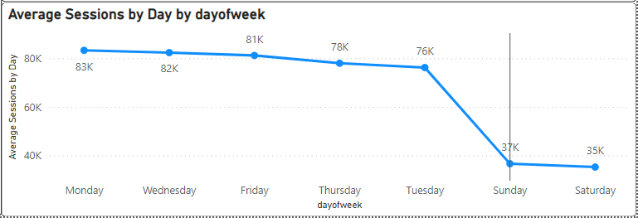
Average sessions by day of the week
Highest and lowest performing weeks:
Sunday and Saturday are lowest performing weeks both in terms of session visits ad purchases
Possible reason for low website visits on weekends:
In countries like USA most people would like to spend the time going outside during weekends

Slide 32
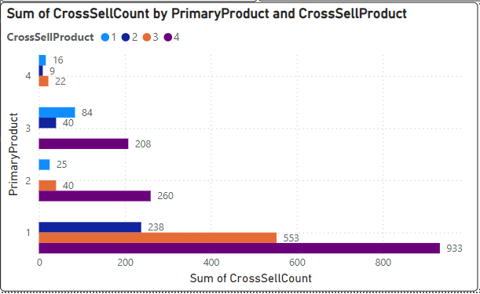
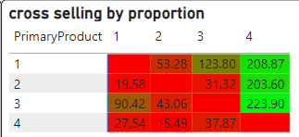
Cross Selling
Most frequently cross selled product with other products:
Product 4 stands out as most frequently bought secondary product with other 3 products
In the matrix out of every 1000 product 1 purchases product 4 was cross sold 206.87 times
Similarly product 4 shows high rate of cross selling capacity with product 2 and 3 as well
Suggestions: through our website after a product was bought we can suggest most frequently bought products and give some discounts in that way more people would show interest in purchasing other products

Slide 33
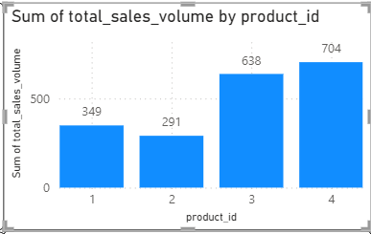
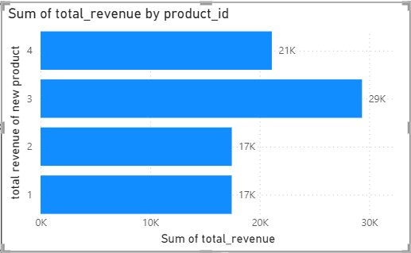
New product performance
These graphs represent new product performance with in first 3 months in sales volume and revenue
Product 4 being the most easily cross selling product we can see huge no of sales volume for product 4 compared to other 3
When we come to the revenue generated, product 4 lags behind product 3 due to the product cost

Slide 34
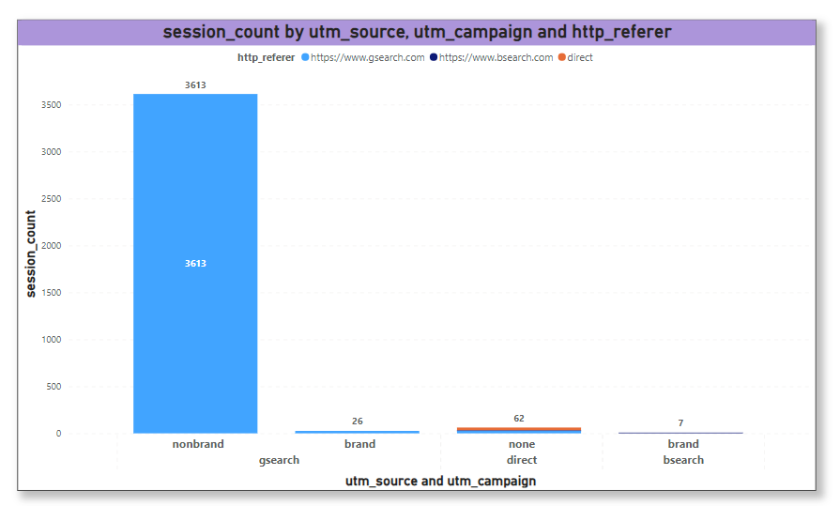
Finding Top Traffic Sources
Insights: Gsearch is the dominant traffic source, indicating strong performance of non-branded Google search campaigns.
Recommendations: Given the success of non-branded Google search traffic, continue to invest in and optimize these campaigns.

Slide 35
Gsearch, Nonbrand Conversion Rate
Total Sessions | 3613
Total Orders | 107
CVR | 2.96%
Insight: This CVR is below the 4% threshold, indicating that the effectiveness of converting non-branded Google search traffic into orders is suboptimal.
Recommendations : Since the CVR is less than 4% threshold, we have to reduce the bid to optimize spending efficiency. Redirect budget to higher-performing campaigns or other marketing initiatives.

Slide 36
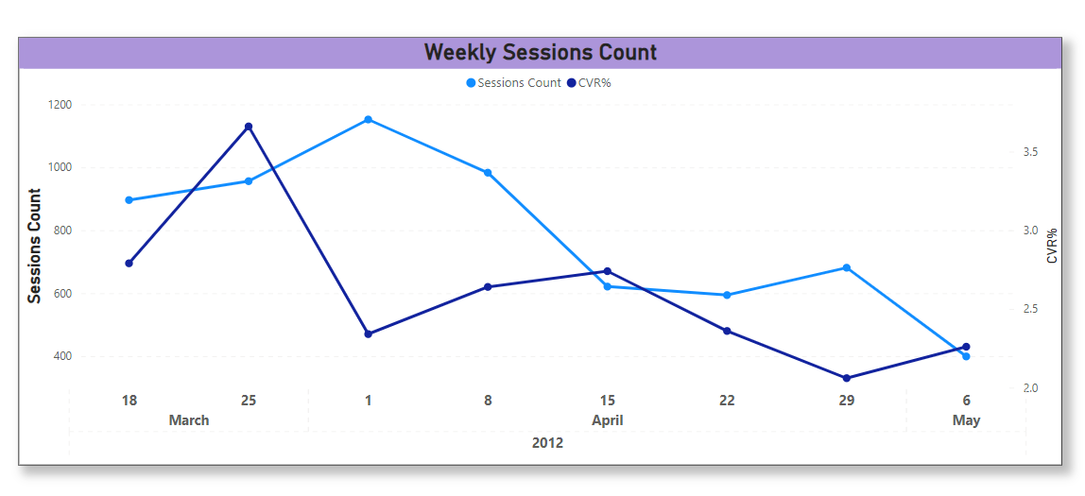
Traffic Source Trending For gsearch nonbrand
Insights:
Sessions for Gsearch nonbrand campaign is impacted by bid change.
The session volume and CVR% after 2012-04-15 has dropped.
Recommendation:
We want to maximize volume at the lowest possible bid.

Slide 37
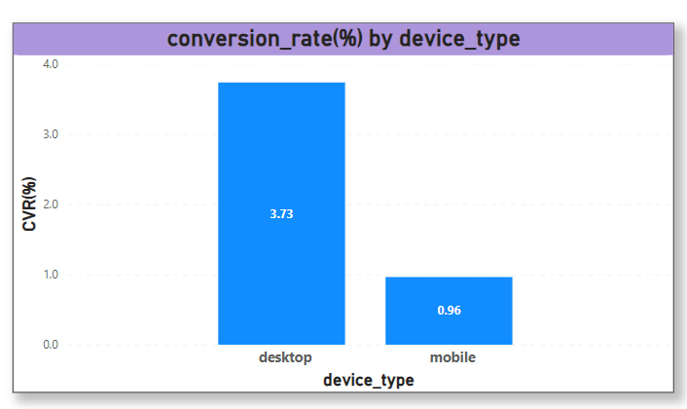
Traffic Conversion By Device Type For gsearch nonbrand
Insights:
Desktop performance is better than mobile for gsearch, nonbrand campaign
Recommendation:
Desktop bids are driving nearly 4% of session to successful orders rate, so we should reduce mobile bids and transfer the paid traffic spent to desktop channel instead

Slide 38
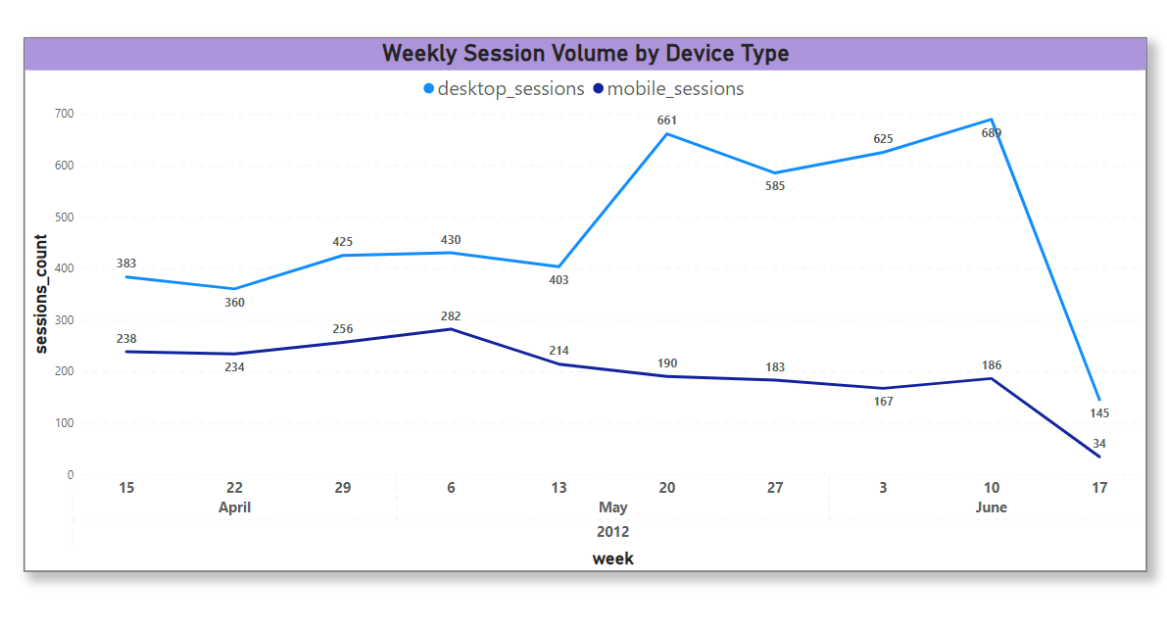
Traffic Source Segment Trending For gsearch nonbrand
Insights:
Conversely, mobile sessions did not benefit from the desktop bidding increase and even showed a slight decline.
Recommendation:
Evaluate the cost-effectiveness and ROI of the increased desktop traffic to ensure that the additional spend translates into conversions and revenue
After biding up desktop channel on 2012-05-19, desktop sessions saw a notable rise immediately after the bidding increase, indicating the strategy's effectiveness in driving more desktop traffic.

Slide 39
TRAFFIC ANALYSIS
(RECOMMENDATION)
Optimize Bids: Given the decline in traffic post-bid changes, it is crucial to carefully monitor and adjust bids to maintain traffic levels.
Focus on Desktop: Increase bids for desktop traffic to leverage its higher conversion rate.
Improve Mobile Traffic :
Mobile-Friendly Design: Our website and app need to be fully responsive and optimized for mobile devices
Social Media Ads: We need mobile-specific ads on platforms like Instagram, Facebook, and TikTok, which have high mobile user engagement.
Mobile-Specific Promotions: Offer exclusive discounts or promotions for mobile users to incentivize mobile purchases.

Slide 40
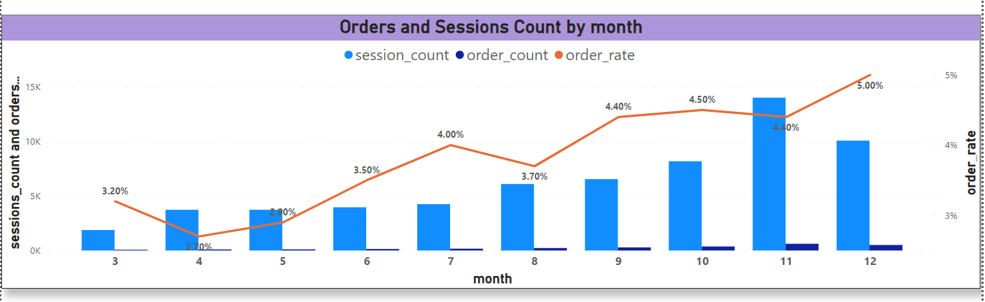
Seasonality Analysis Monthly Trend
Insights:
There is a clear upward trend in both number of visitors and orders all year for 2012.
The highest session counts and order counts occur in around November, possibly indicating a strong holiday season impact.

Slide 41
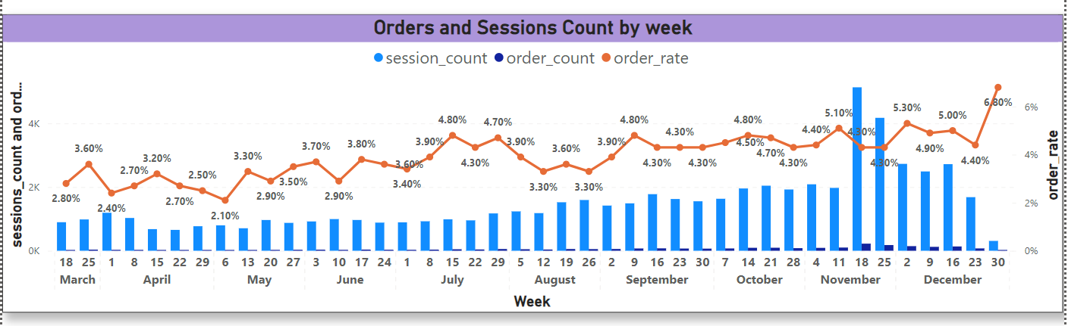
Seasonality Analysis Weekly Trend
Insights:
There is a significant spike in sessions and orders during the week of November indicating a strong holiday season impact(Black Friday, Cyber Monday, etc)
A notable peak in order rate in the last week of December at 6.8%, likely due to Christmas sales.

Slide 42
Seasonality Analysis (Recommendations)
Leverage Peak Periods: Focus on intensive marketing and promotional efforts during peak periods (October to December) holiday season to capitalize on high seasonal demand.
Resource Allocation: Allocate more resources, including staffing and inventory, during the high-traffic months (October to December) to ensure smooth operations and excellent customer service.
Conversion Rate Optimization: Improve the user experience on the website, such as offering personalized recommendations, simplifying the checkout process, and ensuring fast loading times to improve conversion rates during other months.

Slide 43
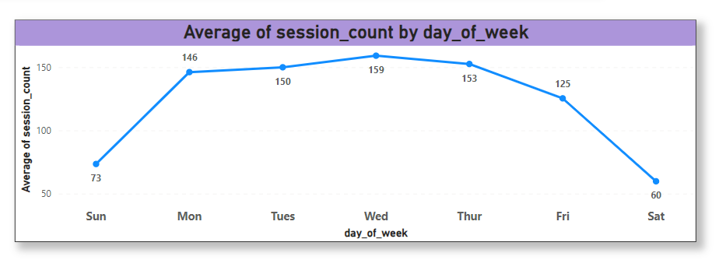
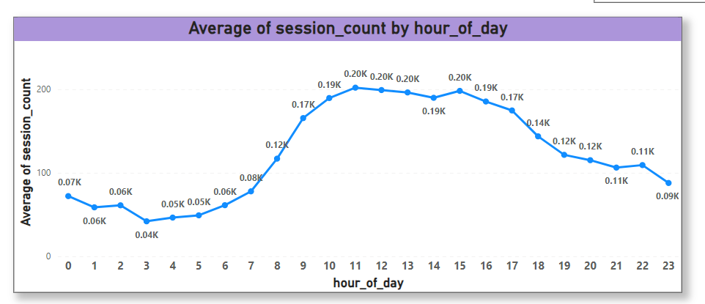
Business Patterns Analysis
Insights:
Weekdays generally see higher session counts compared to weekends. Monday to Thursday have higher traffic than Friday to Sunday.
Within the day, session volume is significant especially between 8 AM and 5 PM . This indicates peak user activity during mid-day within the day.

Slide 44
Resource Allocation: Allocate resources (e.g. staffing levels and operational support) based on these peak times to ensure a smooth user experience and handle increased traffic efficiently.
Address Weekend Traffic: Evaluate the reasons for lower weekend traffic and explore strategies to drive more activity, such as exclusive weekend offers or content.
Business Patterns Analysis (Recommendations)

Slide 45
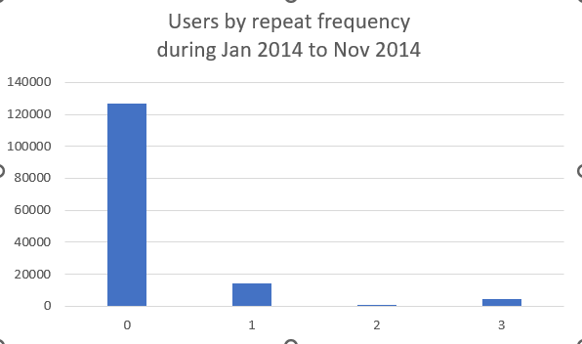
User Analysis
During Jan 2014 to Nov 2014
Repeat Visitors
Insights:
A significant percentage 15% of visitors return after their first session , indicating strong repeat behavior.
Repeat Behavior
Insights:
On average, visitors return after 34 days, with a maximum gap of 69 days and a minimum of 1 day.

Slide 46
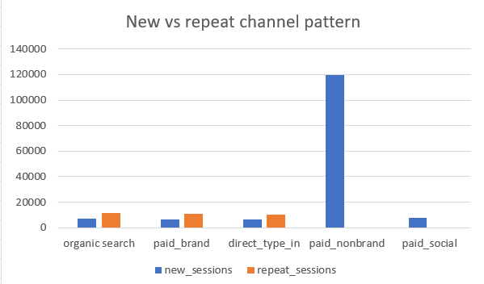
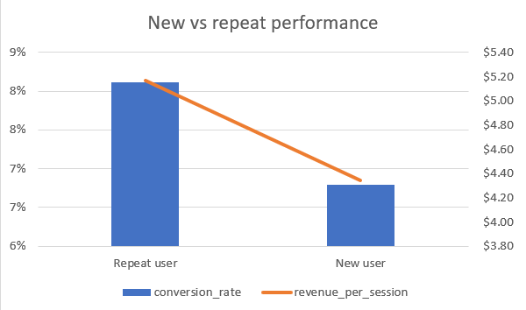
User Analysis
During Jan 2014 to Nov 2014
News vs Repeat Channel Pattern
Insights:
New Visitors: Mostly come through paid nonbrand channels.
Repeat Visitors: Typically arrive via organic search, direct type-in, and paid brand channels.
News vs Repeat Performance
Insights:
Repeat Visitors: Exhibit a higher conversion rate and generate more revenue per session compared to new visitors.

Slide 47
User Analysis (RECOMMENDATION)
Enhance User Retention:
Points and Rewards: Implementing a loyalty program where users earn points for every purchase, which can be redeemed for discounts, free products, or other rewards.
Re-Engagement Campaigns: Identifying inactive users and send targeted re-engagement emails with special incentives to bring them back.
Regular Surveys: Conducting regular surveys to gather feedback and understand user needs and preferences.
Act on Feedback: We need to show users that their feedback is valued by implementing changes and improvements based on their suggestions.
Drop-off Points: Analyzing user behavior to streamline the user journey and reduce drop-off points

Slide 48
Channel Portfolio: Paid vs. Free Traffic
Channel Portfolio: A collection of marketing channels used to drive traffic to the website. Includes:
Paid Traffic: Traffic generated from paid advertising campaigns.
gsearch: Traffic originating from Google ads.
bsearch: Traffic originating from Bing ads.
socialbook: Traffic originating from social media platforms.
Free Traffic: Traffic that comes organically without any paid promotions.
Direct Type-In: Traffic from users who type the URL directly into their browser, i.e users type in the website link in the browser's search bar.
Organic: Traffic that comes from unpaid search engine results pages (SERPs) without paid advertising. It's generated through SEO efforts, meaning the website appears in search results based on its relevance to the search query, not through paid ads.

Slide 49
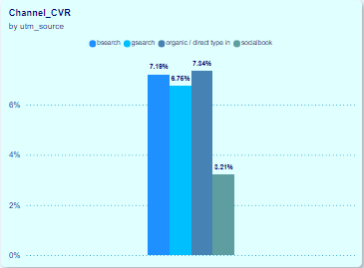
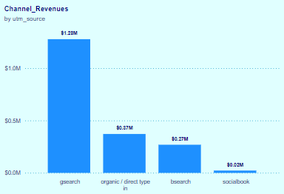
Insights:
Top Performer: gsearch​
Dominates with 316,035 sessions and 21,333 orders.​
Shows steady growth with a peak towards the end of 2014 and 2015.​
High engagement with significant contribution from both mobile (31.95%) and desktop (69.03%) sessions.​
Revenue: $1.27M​
Conversion Rate: 6.65%​
​Mid-Range Performer: bsearch​
62,823 sessions and 4519 orders.​
Mobile Sessions: 7514 (13.68%), Desktop Sessions: 47,395 (86.32%).​
Revenue: $0.27M​
Conversion Rate: 6.95%​
​Low Performer with Potential: socialbook​
Lowest sessions (10,685) and orders (343).​
Only present from 2014 to 2015, indicating late entry but potential for growth.​

Slide 50
Recommendations
Focus on Best Performing Channels:
Continue investing in gsearch as it shows the highest engagement and revenue.
Prioritize both mobile and desktop campaigns to maximize returns.
Improve Paid Traffic Conversion Rates:
Focus on optimizing paid traffic campaigns to increase conversion rates from 6.72%.
Leverage high session volume (389,543) for potential conversion improvements.
Enhance Mobile User Experience:
Conversion Rate: 3.09%.
Focus on enhancing mobile user experience to capitalize on significant mobile traffic volume.
Optimize Campaigns for Mid-Range Performers: bsearch
Evaluate and optimize campaigns to improve performance and conversion rates.
Focus on increasing mobile traffic engagement.
Explore High Potential Channels: socialbook
Implement targeted campaigns to increase engagement and conversion rates.
Explore opportunities to boost sessions and orders given its late entry but potential for growth.
Leverage Free Traffic Effectively:
Despite lower volume, free traffic has a higher conversion rate (7.34%).
Consider strategies to increase free traffic sessions while maintaining high conversion rates.

Slide 51
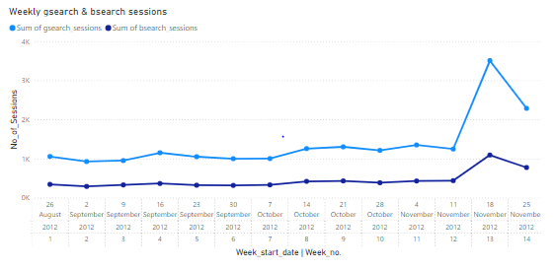
Analyzing Channel Portfolio
Weekly sessions data for both gsearch and bsearch from august 22nd to november 29th

Slide 52
Insights
Weekly Trend Analysis:
Growth Trajectory: Since the launch, both gsearch and bsearch have shown steady session volumes. While gsearch remains dominant, bsearch is gaining traction.
Significant Growth Periods: Notable increases in session volumes are observed in October and November for both channels, indicating effective campaigns or seasonal trends.
High Traffic Periods: The highest session volumes for both channels occur in mid-November (week 13), potentially due to pre-holiday campaigns.
Channel Contribution:
bsearch Performance: bsearch consistently contributes about a third of the session volume compared to gsearch. This ratio suggests that while gsearch is the primary driver, bsearch plays a substantial role.
Session Volumes: The spike in gsearch sessions in mid-November (3508 sessions) and bsearch (1093 sessions) indicates high engagement during this period.
Channel Stability:
Consistent Performance: Both channels show relatively stable session volumes week-over-week with occasional spikes, implying consistent performance and audience engagement.
Scalability: The consistent ratio between the channels suggests that bsearch can potentially scale further, given its significant share of the traffic.

Slide 53
Recommendations
Optimize bsearch Campaigns:
Targeted Campaigns: Develop specific campaigns for bsearch to exploit its growing user base. Focus on keywords and ad creatives that resonate with the bsearch audience.
Performance Analysis: Regularly analyze bsearch metrics to identify high-performing segments and allocate more budget to these areas.
Cross-Channel Strategies:
Integrated Campaigns: Design campaigns that leverage both gsearch and bsearch, ensuring a cohesive strategy that maximizes reach and engagement.
Comparative Analysis: Conduct detailed comparative analysis to understand differences in user behavior and optimize strategies for each channel.
Seasonal Campaign Planning:
Pre-Holiday Promotions: Based on the November peak, plan and execute robust pre-holiday campaigns to maximize traffic and conversions.
Continuous Engagement: Maintain engagement during off-peak seasons with special offers, loyalty programs, and targeted promotions.
Data-Driven Decisions:
Continuous Monitoring: Set up regular monitoring and reporting to track the performance of both channels. Use insights to make informed decisions and adjust strategies dynamically.
User Segmentation: Segment the audience based on behavior and preferences in each channel to deliver personalized experiences.

Slide 54
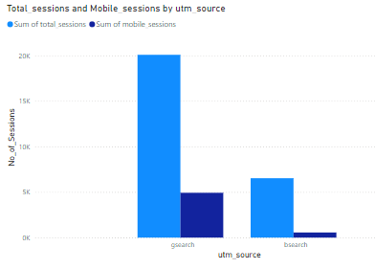
Comparing Channel Characteristics
Mobile sessions data for non-brand campaigns of gsearch and bsearch from august 22nd to november 30th, including details such as utm_source, total sessions, mobile sessions,
and the percentage of mobile sessions

Slide 55
Insights
Device Distribution:
gsearch Dominance on Mobile: gsearch has a significantly higher percentage of mobile sessions (24.52%) compared to bsearch (8.62%). This indicates a stronger mobile presence for gsearch.
Desktop Preference for bsearch: The lower mobile session percentage for bsearch suggests that its audience predominantly accesses it via desktop, highlighting a device-specific user behavior.
Traffic Volume:
Higher Total Sessions for gsearch: gsearch nonbrand campaign has attracted a substantially larger total session volume (20,073) compared to bsearch (6,522). This shows gsearch's broader reach and higher user engagement.
Mobile Session Volume: Despite bsearch’s lower percentage of mobile sessions, it still has a notable volume of mobile users (562 sessions), which presents opportunities for targeted mobile campaigns.
User Behavior:
Different User Segments: The distinct mobile vs. desktop split suggests that gsearch and bsearch cater to different user segments. gsearch might be appealing to a more mobile-centric audience, while bsearch is more desktop-oriented.
Potential for Optimization: Understanding these user behavior patterns can inform targeted strategies to optimize bids and campaigns for each device type, ensuring better performance and user experience.

Slide 56
Recommendations
Device-Specific Campaigns & Enhanced UX:
Mobile Optimization for gsearch: Since gsearch has a higher mobile traffic percentage, optimize mobile-specific ads, landing pages, and focus on improving mobile site speed, navigation, and overall user experience to retain and convert mobile visitors to capitalize on this segment.
Desktop Focus for bsearch: Enhance desktop-targeted campaigns for bsearch, ensuring that the user experience and ad creatives are tailored to desktop users. Ensure that desktop landing pages are optimized for engagement, with intuitive design, and fast load times.
Bid Adjustments:
Differentiated Bidding Strategies: Implement separate bidding strategies for mobile and desktop across both channels. Allocate higher bids for gsearch mobile campaigns and focus on competitive bids for bsearch desktop campaigns.
Performance Monitoring: Continuously monitor and adjust bids based on device performance metrics to maximize ROI and improve conversion rates.
Cross-Channel Insights:
Leverage gsearch Mobile Insights for bsearch: Use insights from gsearch’s mobile performance to experiment with mobile campaigns on bsearch. Identify what works on gsearch and replicate successful strategies on bsearch.
Audience Segmentation: Segment audiences based on device usage and tailor marketing messages accordingly. This can enhance relevance and engagement, driving better results.

Slide 57
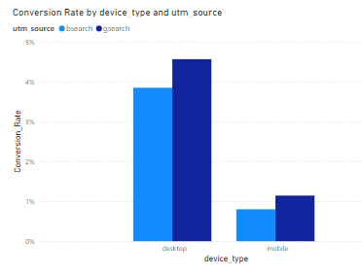
Cross-Channel bid Optimization
gsearch and bsearch nonbrand conversion rates from session
to orders and slice by device type from 22 Aug - 18 Sep

Slide 58
Insights
Conversion Performance Comparison
Desktop Conversion Rates:
gsearch: Conversion rate is higher at 4.56% (130 orders out of 2850 sessions).
bsearch: Lower conversion rate at 3.85% (43 orders out of 1118 sessions).
This indicates that gsearch performs better on desktop devices in converting sessions to orders.
Mobile Conversion Rates:
gsearch: Conversion rate is higher at 1.14% (11 orders out of 962 sessions).
bsearch: Lower conversion rate at 0.8% (1 order out of 125 sessions).
gsearch also shows better performance on mobile devices compared to bsearch in terms of conversion rates.
Device Type Analysis
Desktop:
gsearch outperforms bsearch with a conversion rate of 4.56% compared to 3.85%.
This suggests that desktop traffic driven by gsearch is more likely to convert to orders.
Mobile:
gsearch leads again with a conversion rate of 1.14%, while bsearch lags behind at 0.8%.
Despite both having lower conversion rates on mobile, gsearch shows a relatively better performance.

Slide 59
Recommendations
Adjust Bidding Strategy
Bid Down on bsearch:
Given the lower conversion rates for bsearch on both desktop and mobile, consider reducing bids for bsearch campaigns. This will help optimize the budget allocation and ensure higher ROI.
Action: Lower bids on bsearch nonbrand campaigns to reflect their lower conversion efficiency.
Focus on High Performing Channels
Leverage gsearch:
With higher conversion rates on both desktop and mobile, increase bids or allocate more budget towards gsearch nonbrand campaigns to maximize conversions.
Action: Increase bids on gsearch nonbrand campaigns to capitalize on their higher conversion rates.

Slide 60
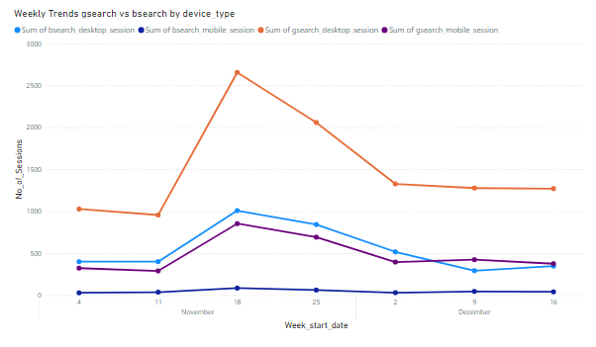
Channel Portfolio Trends
Weekly sessions for gsearch and bsearch nonbrand traffic by device type

Slide 61
Insights
Channel Performance Differentiation:
Desktop Sessions:
bsearch: From 4th November to 22nd December, bsearch desktop sessions consistently hovered around 38%-41% of gsearch sessions.
Drop-off: There was a notable drop on 2nd December when bsearch desktop sessions fell to 22.94% of gsearch sessions. This drop aligns with the reduction in bids but might also be influenced by the post-Black Friday and Cyber Monday period.
Mobile Sessions:
bsearch: Mobile sessions consistently maintained lower percentages compared to desktop, around 8.97%-12.76%.
Fluctuations: There was a sharp drop on 2nd December (7.83%) and noticeable fluctuations throughout December, suggesting multiple influencing factors beyond just bid adjustments.

Slide 62
Recommendations
Adjusting Bids and Budgets:
Desktop Bids Adjustment:
Stabilize: Given the consistency prior to the drop, consider maintaining a moderate bid level that reflects the initial performance (around 38%-41%).
Seasonal Strategy: Develop a seasonal bidding strategy that accounts for expected fluctuations around major shopping events (Black Friday, Cyber Monday) to prevent overreaction to natural dips.
Mobile Strategy Enhancement:
Targeted Campaigns: Invest in targeted mobile campaigns during stable periods to test if focused efforts can stabilize performance.
Bid Modifiers: Use bid modifiers to adjust bids based on device performance. Increase bids for devices showing higher conversion rates.
A/B Testing: Implement A/B testing for different bid strategies on bsearch to identify the optimal bid levels for both desktop and mobile..
Cross-Channel Synergy:
Integrated Campaigns: Run integrated campaigns across both gsearch and bsearch to leverage the strengths of each channel.
Retargeting: Utilize retargeting strategies to recapture bsearch users who did not convert initially, potentially increasing the overall effectiveness of bsearch campaigns.

Slide 63
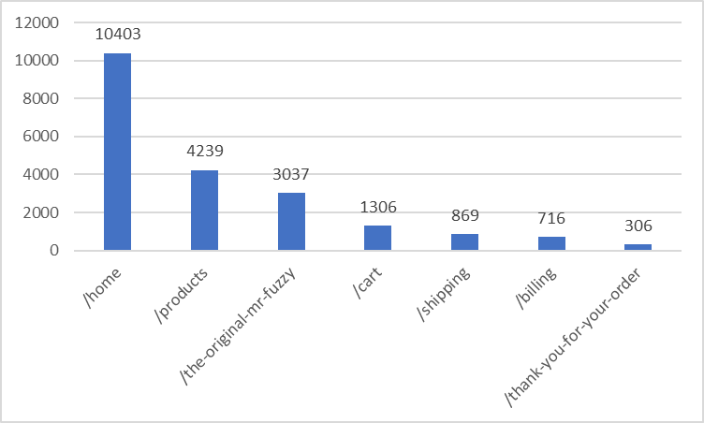
Identifying Top Website Pages

Slide 64
Identifying Top Entry Pages before '2012-06-12'
pageview_url | page_count
/home | 10714
Insights
High Traffic on Home Page:
The /home page has a significant number of page views, indicating it is a primary landing page for visitors. This is typical as the home page often serves as the entry point to a website.
Recommendations
Optimize Content Placement:
Ensure that the most important and frequently accessed content is prominently placed on the home page. This could include featured products, services, latest news, or important announcements.
Improve User Experience:
Analyze the layout and design of the home page to ensure it provides a seamless user experience. This can involve A/B testing different designs to see which performs best in terms of engagement and conversions

Slide 65
Bounce Rates
Insights
High Bounce Rate:
The home page has a bounce rate of 59.18%, meaning that 59.18% of visitors leave the site after viewing the home page without interacting further,traffic that isn't engaging beyond the initial page.
Recommendations
Content Review:
Relevance: Ensure that the content on the home page is highly relevant to what users are likely seeking.
Navigation Improvement:
Clear Pathways: Provide clear and easy pathways to other parts of the site. Use prominent and intuitive navigation menus.
landing_page | total_sessions | bounced_sessions | bounce_rate
Home | 11048 | 6538 | 59%

Slide 66
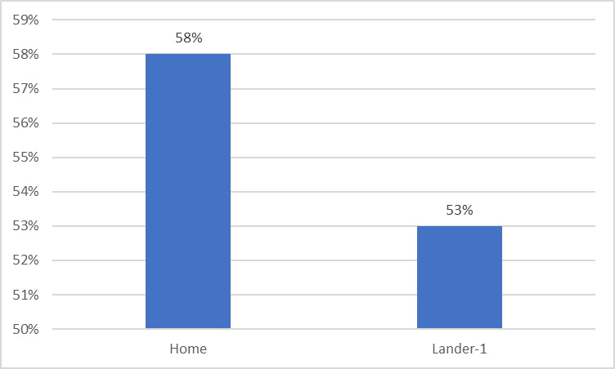
Analyzing Landing Page Tests

Slide 67
Insights
Bounce Rate Comparison:
The home page has a bounce rate of 58%, while Lander-1 has a slightly lower bounce rate of 53%. This indicates that Lander-1 is performing marginally better in retaining visitors.
Total Sessions:
The total sessions for both pages are relatively similar, with the home page at 2,261 sessions and Lander-1 at 2,316 sessions.
Bounced Sessions:
The number of bounced sessions is close for both pages, with 1,319 for the home page and 1,233 for Lander-1.
Recommendations
Compare and Analyze Content:
Review the content on both pages to identify what might be causing users to engage more with Lander-1. Analyze elements like content layout, multimedia usage, and calls to action (CTAs).
Enhance Home Page Engagement:
Interactive Elements: Incorporate more interactive elements such as videos, sliders, or infographics to capture user interest on the home page.

Slide 68
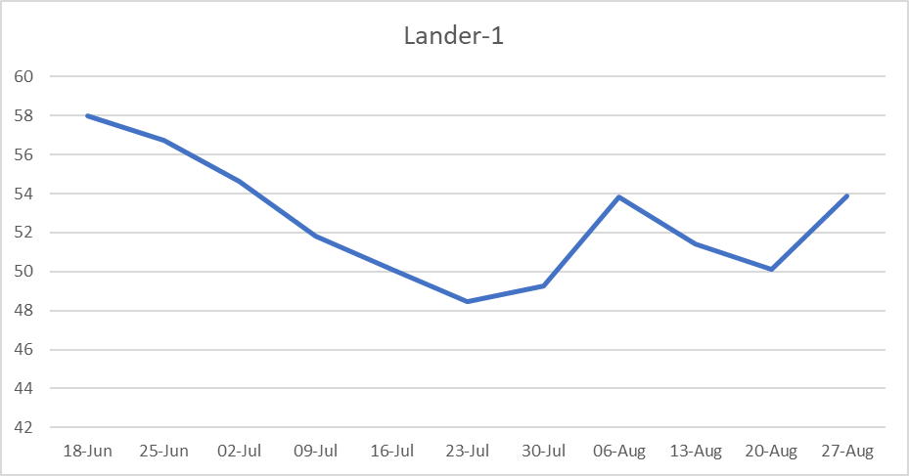
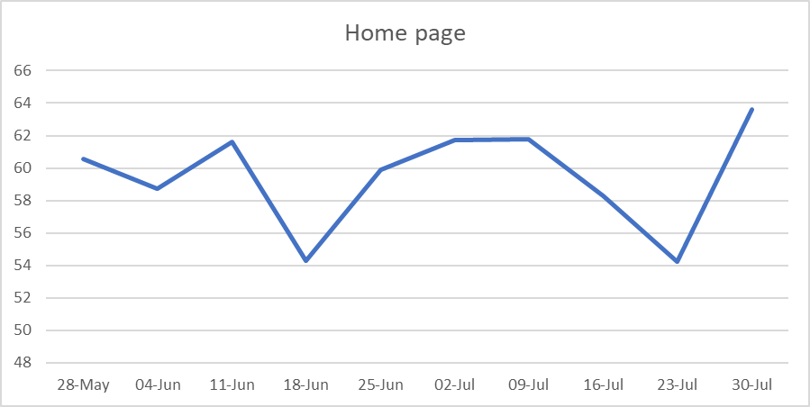
Landing Page Trend Analysis

Slide 69
Insights
Overall Performance: The /lander-1 page generally has a lower bounce rate compared to the /home page throughout the observed period. This indicates that /lander-1 is more effective in engaging users.
Bounce Rate Peaks and Troughs: Both pages show fluctuations in bounce rates, but /home exhibits higher variability with several peaks above 60%. The /lander-1 page shows a steady decline in bounce rate until late July, suggesting improved user engagement over time, before experiencing a slight increase in August.
Effectiveness of Landing Pages: The /lander-1 page consistently performs better in terms of bounce rates compared to the /home page, making it a more effective landing page for retaining traffic from the gsearch nonbrand campaign.
Recommendations
Focus on /lander-1: Given the lower and more stable bounce rates, consider driving more of the gsearch nonbrand traffic to the /lander-1 page. This page appears to engage users more effectively.
Analyze Bounce Rate Increases: Investigate the reasons behind the bounce rate peaks on the /home page, particularly in mid-June and late July. Factors such as changes in content, loading speeds, or external influences might be affecting user engagement.

Slide 70
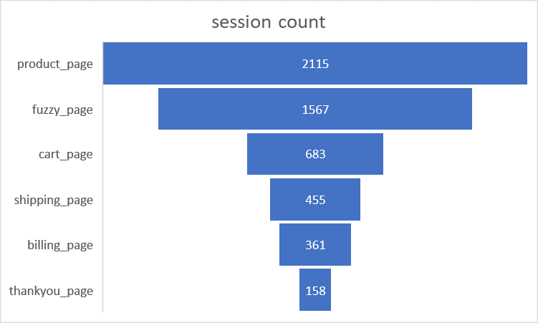
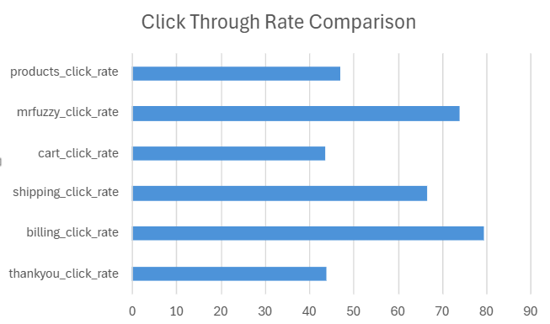
Conversion Funnels of click percentages for pageview_url and respective session count:

Slide 71
Insights
Drop-off Analysis:
There's a significant drop-off from the product page (2,115 sessions) to the cart page (683 sessions).
Further drop-offs are observed from the cart page to the shipping page (455 sessions), and from the shipping page to the billing page (361 sessions), ending with 158 sessions on the thank you page.
Click Rates:
The highest click rate is on the billing page (79.34%) and the fuzzy page (74.09%).
The lowest click rates are for the thank you page (43.77%) and the cart page (43.59%).
Recommendations:
User Reviews: Highlight user reviews and ratings to build trust and encourage purchases.
Save Cart Feature: Allow users to save their cart for later or email their cart contents to themselves.
Prominent Checkout Button: Ensure the checkout button is easy to find and click.
Multiple Shipping Options: Offer various shipping options to cater to different needs (e.g., standard, express).
Payment Options: Offer multiple payment methods to accommodate different preferences.

Slide 72
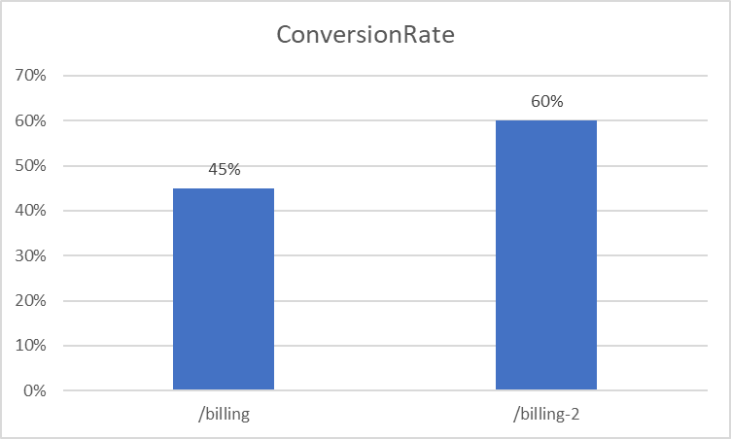
Analyzing,/billing vs. new /billing-2 pages

Slide 73
Insights
Higher Traffic for /billing-2:
The /billing-2 page has significantly higher traffic with 48,441 total page views compared to 3,617 for the /billing page. This indicates a strong preference or higher traffic allocation towards the new billing page.
Higher Conversion Rate for /billing-2:
The conversion rate for /billing-2 is substantially higher at 60% compared to 45% for the /billing page. This suggests that the new billing page is more effective at converting visitors into orders.
Significant Increase in Total Orders:
The total orders for /billing-2 are 30,693, while /billing has only 1,620. This massive difference is a clear indicator that the new billing page performs better in driving conversions.
Recommendations​
Implement /billing-2 as the Default Billing Page:​
Given the higher conversion rate and total orders, it is advisable to make /billing-2 the default billing page for all users. The improved performance indicates that users find it easier or more appealing to complete their purchases on this page​

Slide 74
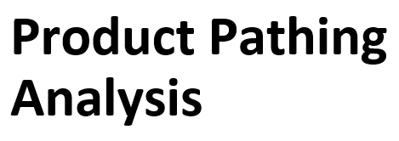
Since the launch of the Love Bear product, the percentage of clicks from the /products page to the Mr. Fuzzy product page has decreased.
However, the overall click-through rate for the /products page has increased.
This suggests that the Love Bear product is generating additional interest in products overall.
It is recommended that the conversion funnels for each product be investigated individually to better understand how the Love Bear product is impacting customer behavior.

Slide 75
Insights
Click Rate Comparison:
The click rate for the "furry post" is significantly higher at 62.13% compared to the "bear post" at 14.44%.
Audience Engagement:
The higher click rate for the "furry post" indicates that it is more engaging or relevant to the audience than the "bear post."
Recommendations
Analyze Content:
Furry Post: Identify the elements that contribute to the high click rate. This could include the topic, headlines, images, call to actions, or content format.
Bear Post: Review the content to understand why it has a lower engagement. Consider the topic relevance, clarity, and appeal of the post.
Replicate Success Factors:
Apply successful elements from the "furry post" to other posts. This might involve using similar headlines, visual styles, or content structures.

Slide 76
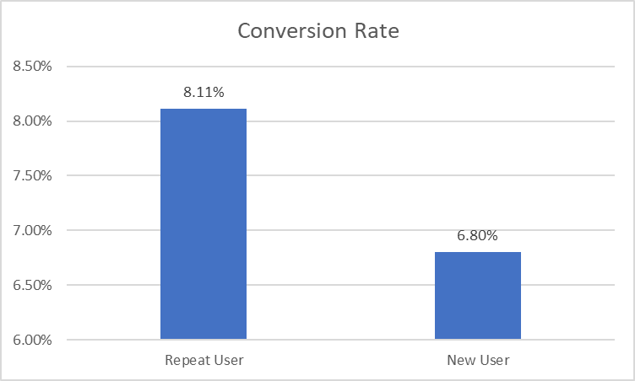
New Users VS Repeat Users
User Type | Revenue per Session
Repeat User | $5.17
New User | $4.34

Slide 77
Insights
Recommendations​
Conversion Rate:
Repeat Users have a higher conversion rate (8.11%) compared to New Users (6.80%). This indicates that repeat users are more likely to make a purchase compared to new users.
Revenue Per Session:
Repeat Users generate more revenue per session ($5.17) compared to New Users ($4.34). This further emphasizes the value of repeat customers in driving higher revenue.
User Distribution:
The number of sessions for New Users (149,787) is significantly higher than for Repeat Users (33,577). While the bulk of traffic comes from new users, the quality and conversion efficiency are higher for repeat users.
Retention Strategies:​
Focus on customer retention strategies to increase the number of repeat users. This can include loyalty programs, personalized marketing, and exceptional customer service. Since repeat users convert at a higher rate and generate more revenue per session, increasing their numbers can significantly boost overall revenue.​
Targeted Marketing Campaigns:​
Run targeted marketing campaigns for both user groups:​
Repeat Users: Offer exclusive deals, early access to new products, and loyalty rewards.​
New Users: Provide welcome discounts, informative content to guide them through the purchase process, and highlight unique selling points to encourage conversions​​

Slide 78
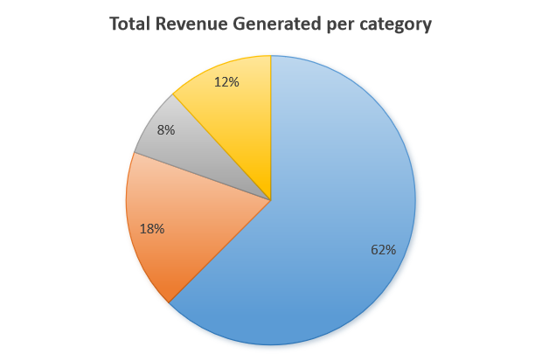
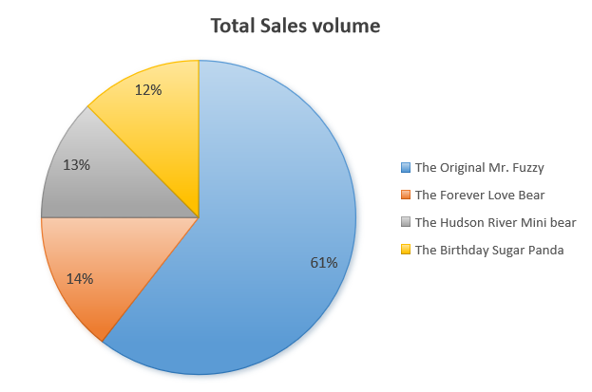
Insight:
Distribution of revenue by volume is nearly similar except for THE HUDSON RIVER MINI BEAR which have share as 13% by volume and 8 % by revenue
And THE BIRTHDAY SUGAR PANDA which is 14% of volume and 18 % of sales
Recommendations:
For the product THE HUDSON RIVER MINI BEAR there we can increase the margin to balance the distribution of those two parameters

Slide 79
Insights:
Top Performer:
The Original Mr. Fuzzy has the highest total revenue of $1,419,767 and the highest sales volume of 23,861 units. Its profit percentage is 163.01%, indicating strong profitability.
High Profit Margin:
The Hudson River Mini Bear has the highest profit percentage at 211.59%, despite having the lowest total revenue ($19,775.72) and sales volume (581 units).
The Birthday Sugar Panda follows closely with a profit percentage of 209.44%, showing excellent profitability.
Solid Mid-Range Performer:
The Forever Love Bear has the second-highest revenue ($318,109.19) and a strong profit percentage (170.13%).

Slide 80
Recommendations :
Focus on Best Sellers:
Increase marketing efforts for The Original Mr. Fuzzy as it is the top revenue generator and has strong profitability.
Consider bundling The Original Mr. Fuzzy with other products to boost overall sales.
Promote High Margin Products:
Highlight The Hudson River Mini Bear and The Birthday Sugar Panda in marketing campaigns due to their high profit margins. Explore opportunities to increase their visibility and sales volume.
Expand Product Line:
Develop new products inspired by the features and themes of The Birthday Sugar Panda and The Hudson River Mini Bear to capitalize on their profitability.
Optimize Costs:
Review and optimize production and supply chain costs for The Forever Love Bear to improve its profit percentage further.
Customer Feedback and Improvement:
Collect customer feedback on all products to identify areas for improvement and to enhance customer satisfaction, potentially increasing repeat purchases.

Slide 81
Funnel Chart and Conversion Pattern
Insights:
Total Sessions: There were 472,871 total sessions.
Product Page Views: 55.2% of sessions (261,231) viewed product pages.
Cart Page Views: 20.1% of sessions (94,953) reached the cart page.
Shipping Page Views: 13.6% of sessions (64,484) proceeded to the shipping page.
Billing Page Views: 10.2% of sessions (48,441) continued to the billing page.
Thank You Page Views: 6.8% of sessions (32,313) completed the purchase process
472871
261231
94953
64484
48441
32313

Slide 82
Recommendations:​
Enhance Product Pages: Given the high drop-off from product to cart pages, optimize product pages with clearer calls to action and more compelling product information.​
Streamline Checkout Process: Simplify the checkout process to reduce drop-offs at each stage. Ensure the cart, shipping, and billing pages are user-friendly and efficient.​
Retargeting Campaigns: Implement retargeting strategies for users who drop off before reaching the cart or billing pages.​
Conversion Rate Optimization (CRO): Conduct A/B testing on different page elements, especially on product, cart, and checkout pages, to identify what drives higher conversions.​
Customer Feedback: Gather feedback from users who abandon their sessions at various stages to understand and address their concerns.​
Personalized Recommendations: Use data-driven personalized product recommendations to guide users from the product pages to the checkout

Slide 83
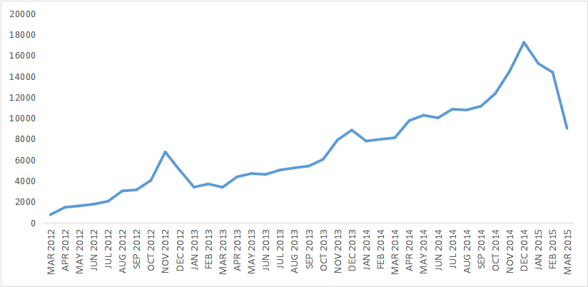
Monthly Trend Of Sessions

Slide 84
Insights
:Steady Growth:
There is a clear trend of steady growth in product page sessions from March 2012 to December 2014. The sessions increased from 743 in March 2012 to a peak of 17,240 in December 2014.
Seasonal Peaks:
Significant peaks are observed during November and December of each year, suggesting higher engagement during the holiday season. For example, November 2012 (6,743 sessions) and December 2012 (5,013 sessions) show a marked increase compared to other months.
Post-Holiday Decline:
There is a noticeable drop in sessions following the peak holiday months. For instance, January 2013 sessions dropped to 3,380 from December 2012’s 5,013.
Continuous Increase:
Despite seasonal fluctuations, the overall trend shows continuous growth. By October 2014, sessions reached 12,335, and by December 2014, they peaked at 17,240.
Recent Decline:
After reaching a peak in December 2014, there is a decline in sessions, with March 2015 showing 9,022 sessions.

Slide 85
Recommendations:​
Leverage Seasonal Trends:
Increase marketing and promotional efforts during the holiday season (November and December) to capitalize on the natural increase in traffic. Offer special deals, discounts, and holiday-themed products to boost sales.
Post-Holiday Campaigns:
Implement post-holiday marketing campaigns to sustain customer engagement and mitigate the drop in sessions seen in January and February. Consider loyalty programs, New Year promotions, and targeted email campaigns.
Sustain Growth:
Maintain consistent marketing efforts throughout the year to sustain the growth trend. Use data-driven insights to identify effective marketing channels and optimize campaigns.
Address Recent Decline:
Investigate the reasons for the decline in sessions starting January 2015. Analyze changes in marketing strategies, website updates, or external factors that might have impacted traffic. Adjust strategies accordingly to reverse the trend.
Enhance User Experience:
Improve the website’s user experience to keep visitors engaged and encourage repeat visits. Optimize page load times, streamline navigation, and ensure mobile compatibility.

Slide 86
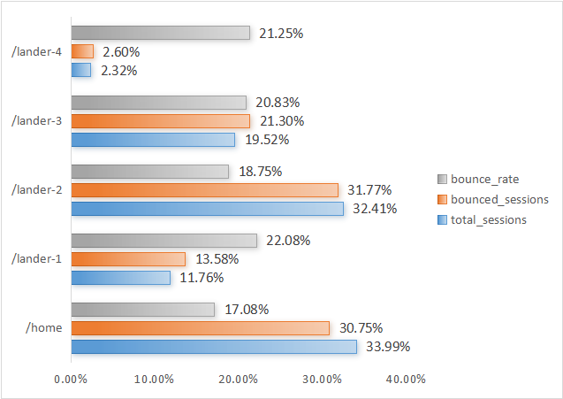
Lander test and it's Distribution

Slide 87
Insights:
Recommendations:​​
High Bounce Rate on Custom Landers:
The custom landing pages (/lander-1, /lander-2, /lander-3, /lander-4) have higher bounce rates compared to the homepage. Specifically, /lander-1 has the highest bounce rate at 53%.
Traffic Concentration:
The homepage receives the highest total sessions, indicating it is the most visited entry point. Conversely, /lander-4 has the fewest sessions, suggesting it is the least effective in attracting visitors.
Consistent Issues Across Landers:
All custom landers have bounce rates above 50%, highlighting a common issue that may be related to their design or content.
Improve Custom Lander Content:​
Reevaluate and enhance the content, layout, and user experience on custom landers to make them more engaging and relevant to reduce the high bounce rates.​
A/B Testing:​
Conduct A/B testing on the landing pages to identify specific elements that cause users to leave. Test different headlines, call-to-action buttons, and page layouts.​
Targeted Traffic Analysis:​
Analyze the sources of traffic to each landing page to understand if certain campaigns or traffic sources are leading to higher bounce rates. Tailor the landing pages to better meet the expectations of these visitors.​

Slide 88

Comparing Desktop And Mobile Users
On Various Matrics

Slide 89
Recommendations:
Enhance Mobile Experience:
Focus on improving mobile site speed, user interface, and checkout process to reduce friction and boost conversion rates.
Mobile-Optimized Campaigns:
Launch targeted marketing campaigns for mobile users, highlighting mobile-exclusive offers and simplified purchase flows.
Cross-Device Integration:
Implement features that allow users to easily transition between devices, such as synchronized shopping carts and wish lists.
A/B Testing:
Conduct A/B tests to identify elements causing lower mobile conversion rates and make data-driven adjustments.
Customer Feedback:
Gather feedback from mobile users to understand pain points and areas for improvement, ensuring enhancements are aligned with user needs.

Slide 90

Product Wise Monthly Sales Trend​

Slide 91
Insights from the Data
The Original Mr. Fuzzy Leads Sales:
Consistently highest sales, and having a consistent overall growth peaking various times in between.
Sustainable growth:
Each product is performing and maintain their growth making themself profitable
Introduction of new products:
Introduction of new products making a great impact in the revenue and profit by 18%.
It is also making a great engagement among the customers by increasing this range of product that they can have.
Marketing and strategies:
The respective campaign and marketing strategies are seems to be perfectly fit for the products and making an impact in increase in the sales.

Slide 92
Recommendations
Seasonal decline in sale:
Obstacle:
As we can see there in product named The Original Mr. Fuzzy we can clearly see a decline in sales at the time of December to march at the same time we have seen a spike in the sales of The Forever Love Bear.
How to overcome :
We need to find the reason behind the decline by the feedback and to find various reasons.
We can also adopt the strategies used by The Forever Love Bear because of its spikes in respective time period.
Increasing the product:
Obstacle:
Lesser number of products give a lesser variety of the products to the customer which may cause customer to change the platform and in search of new product
How to overcome :
Increasing the products with market research and with timing may cause increase in sale and scalability of the company

Slide 93


Quarterly Sessions Distribution
Quarterly Revenue Per Order

Slide 94
Recommendations
Enhance High Conversion Strategies:
Identify and enhance the strategies that contributed to the increased conversion rates. This could include optimizing the checkout process, targeted marketing, and personalized recommendations.
Focus on Q4 Campaigns:
Invest in robust marketing and promotional campaigns in Q4 to leverage the seasonal trend of higher sales during the holiday season.
Improve Revenue per Session:
Implement strategies to further increase the revenue per session. This can be achieved by offering upsells, cross-sells, and personalized product recommendations to increase average order value.
Customer Retention Programs:
Develop loyalty programs and customer retention strategies to maintain and grow the existing customer base. Satisfied customers are likely to make repeat purchases, thereby increasing order count and revenue.
Product and Price Optimization:
Continuously analyze and adjust product offerings and pricing strategies to maximize revenue per order. Introducing limited-time offers and premium products can drive higher revenue per order.
Website and User Experience:
Enhance the user experience on the website to ensure a seamless shopping experience. This can help increase session duration, reduce bounce rates, and improve overall conversion rates.

Slide 95

Impact of introducing new products
launch date | Product_name
19-Mar-2012 | The Original Mr. Fuzzy
6-Jan-2013 | The Forever Love Bear
12-Dec-2013 | The Birthday Sugar Panda
5-Feb-2014 | The Hudson River Mini bear

Slide 96
Insights of analysis
The trend of sales along with the launch of the product shows the proportionality between the sales and the launch date
For each of the launch date we can clearly see a spike in the sales.
This shows the effect of increasing products line gives a wide variety of products to the customers to match their need and also retaining the customers

Slide 97

Classification of Users on the Basis of Activity
Customers are divided on the basis of the activity
Customer's visit > 10 ----------Highly active
Customer's visit between 4-10---- Moderately active
customer visit <4 --------- Less active

Slide 98
Recommendations :
Personalized Engagement:
Implement personalized content, recommendations, and targeted email campaigns to re-engage less active users and encourage deeper interaction.
Exclusive Incentives:
Provide moderately active users with exclusive content, early access to products, special discounts, and loyalty programs to boost their engagement levels.
Optimize User Experience:
Simplify website navigation, ensure responsive design for all devices, and create a seamless user interface to reduce friction and enhance user journeys.
Targeted Marketing:
Run segmented marketing campaigns and retargeting ads to convert less active users into more engaged ones, focusing on personalized messaging.

Slide 99

CEO Dashboard – Traffic Analysis

Slide 100

CEO Dashboard – Product Analysis

Slide 101

CEO Dashboard – Seasonality Analysis

Slide 102

Website Manager Dashboard – Session Analysis

Slide 103

Website Manager Dashboard – Funnel Chart Analysis

Slide 104

Website Manager Dashboard – Repeat & One Time Users Analysis

Slide 105

Marketing Manager Dashboard – Channel Analysis

Slide 106

Marketing Manager Dashboard – Visitors Analysis

Slide 107
GLOSSARY
Revenue Metrics:
Revenue by Volume: The comparison of revenue generated relative to the number of units sold.
Product-Specific Metrics:
Sales Volume: The number of units sold for each product.
Total Revenue: The total income generated from sales of each product.
Profit Percentage: The ratio of profit to revenue, expressed as a percentage.
Session Metrics:
Total Sessions: The total number of user visits to the website.
Page Views: The percentage of sessions viewing specific pages (product, cart, shipping, billing, thank you).
Conversion Funnel:
Drop-off Rate: The percentage of users who abandon the process at each stage of the conversion funnel.
Conversion Rate Optimization (CRO): Strategies to increase the percentage of visitors who complete a desired action, such as making a purchase.
Growth and Seasonal Trends:
Steady Growth: Consistent increase in sessions over time.
Seasonal Peaks: Significant increases in sessions during specific periods, such as holidays.
Post-Holiday Decline: A drop in sessions following peak periods.
Continuous Increase: Overall upward trend in sessions despite fluctuations.

Slide 108
GLOSSARY
Marketing and Campaigns:
Retargeting Campaigns: Ads targeting users who previously interacted with the site but did not complete a purchase.
Personalized Recommendations: Data-driven suggestions of products tailored to individual user preferences.
User Experience and Website Metrics:
Bounce Rate: The percentage of visitors who navigate away from the site after viewing only one page.
Custom Landers: Specific landing pages designed for marketing campaigns.
A/B Testing: Comparing two versions of a webpage to determine which one performs better.
Product Development and Optimization:
New Product Introduction: Launching new products to diversify offerings and engage customers.
Cost Optimization: Improving production and supply chain processes to reduce costs and increase profitability.
Customer Feedback: Collecting input from customers to identify areas for improvement.
Engagement and Retention:
Customer Retention Programs: Strategies to encourage repeat purchases and maintain a loyal customer base.
Personalized Engagement: Tailoring content and recommendations to individual users to increase engagement.
Exclusive Incentives: Special offers and early access to products for targeted user groups to boost engagement.

Slide 109
GLOSSARY
Traffic Sources: The primary channels through which visitors arrive at the website.
Traffic Conversion Rates: The percentage of visitors who complete a desired action (e.g., making a purchase) out of the total number of visitors.
Total Sessions: The total number of individual sessions initiated by all users on the site.
Conversion Rate: The percentage of users who take a desired action (e.g., making a purchase) out of the total number of users.
Traffic Source Bid Optimization: The process of adjusting bids to improve the efficiency and effectiveness of traffic sources.
Repeat Behavior: The patterns and frequency of repeat visits by users.
Channel Pattern: The different channels through which new visitors and repeat visitors arrive at the website.
Channel Performance: The effectiveness of different channels in driving conversions and revenue.
Gsearch Nonbrand: A type of Google search traffic that does not include brand-specific keywords.
Organic Search: Traffic that comes from search engine results that are not paid for.
Direct Type-In: Traffic that comes from users typing the website URL directly into their browser.
Paid Brand: Traffic that comes from paid advertisements featuring the brand name.

